Slide 1

US Crime Analysis
Group 9:
Aditya Trivedi
Amoolya Bagalkoti
Avinash Ranga
Sachin Dewangan
Yashasvi Sharma

Slide 2
Contents:
Hypothesis and Questions
Data Cleaning Process and Dictionary
Data Storage
Statistical Description
Variable Relationship
Plots
Interactive Visualizations
Key takeaways

Slide 3
1. Hypothesis and Questions:
To analyse which agency solved crimes in different regions of the US
Weapons used for crimes that were solved by various agency types
The number of crimes committed by different age groups, gender, and race.
Types of weapons used by the perpetrator and their relationship with the victim.
Crimes committed over the years, since 1980 among multiple states.

Slide 4
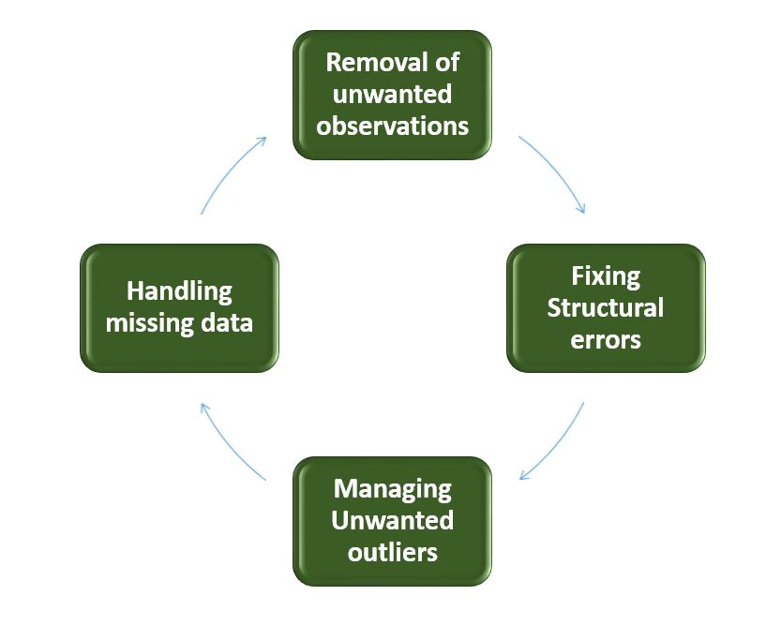
2. Data Cleaning and Dictionary:
The 'state_crime’ dataset had 21 rows and 3115 columns. We converted the data type of the columns from float to int, and removed all the null values.

Slide 5
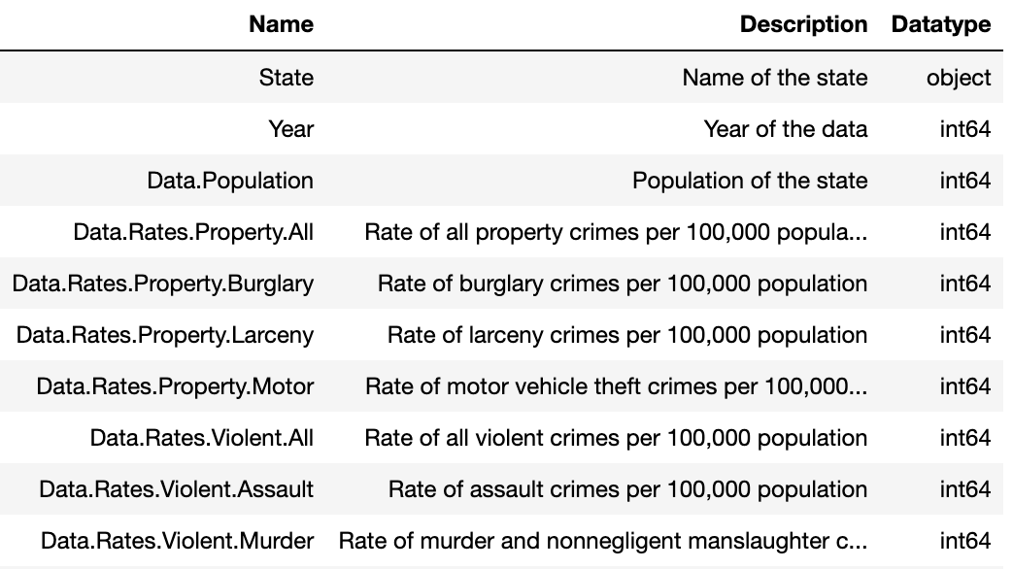
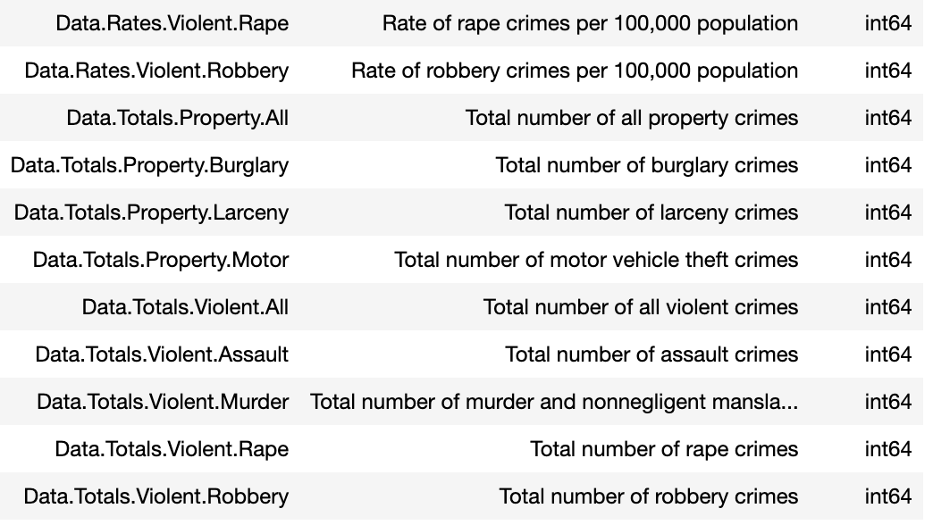
Data dictionary of 'state_crime’ dataset -

Slide 6
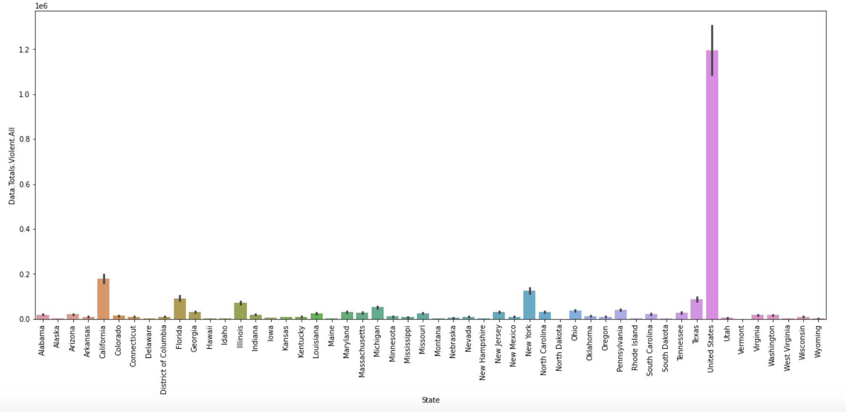
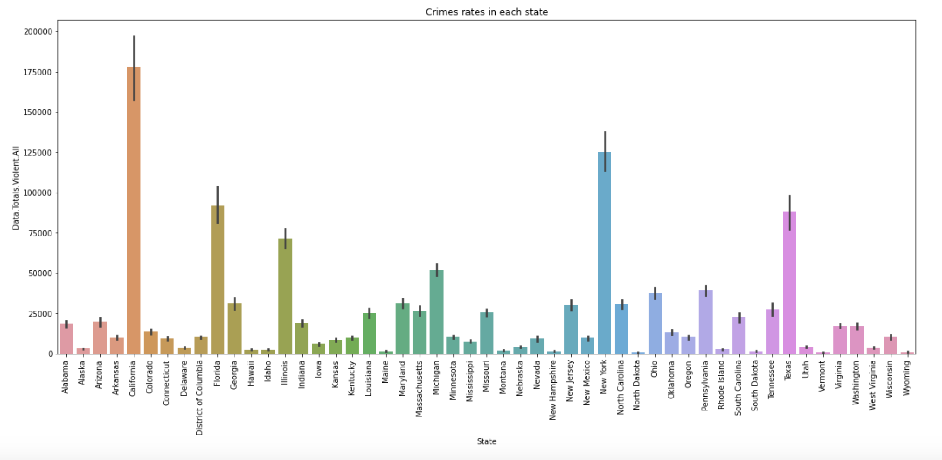
For our 'state_crime’ dataset, we detected and eliminated an outlier row corresponding to the United States, after which we re-plotted the graph.

Slide 7
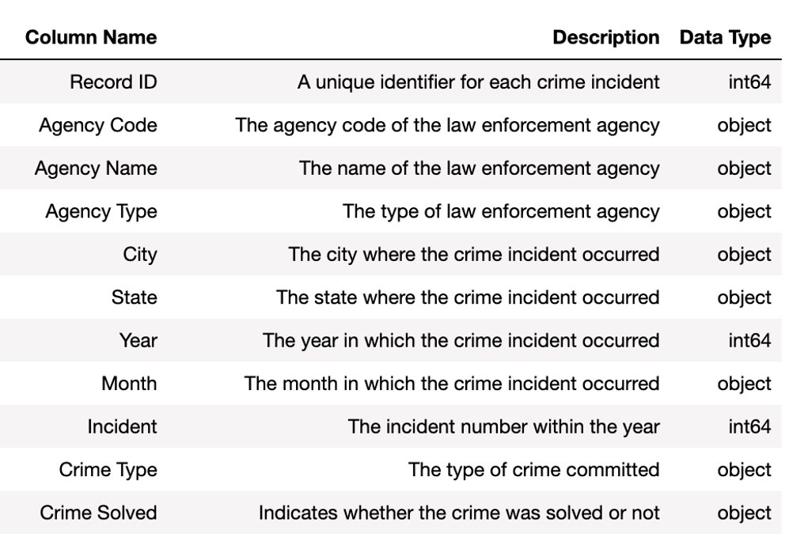
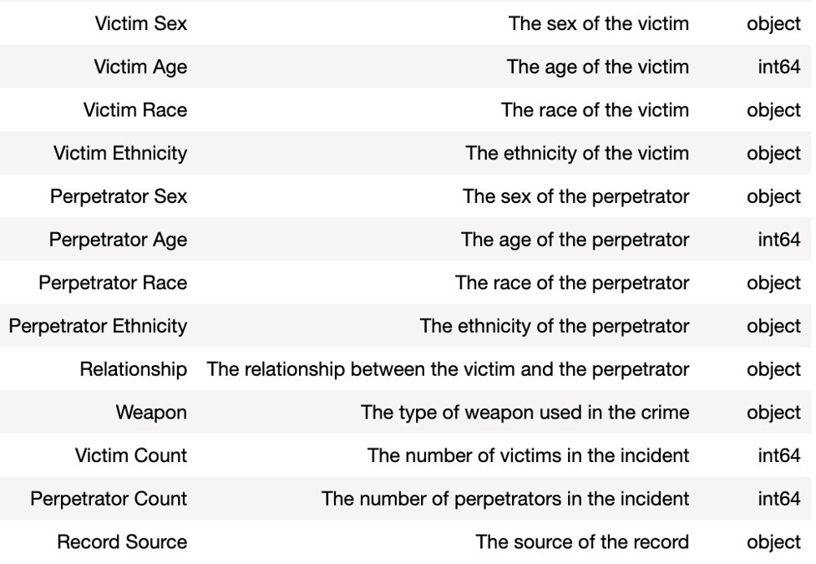
The ‘database’ dataset consisted of 638454 rows and 24 columns. During data preprocessing, we identified that the "Perpetrator Age" column had an object datatype. To clean this column, we replaced empty strings with NAN values and removed the corresponding rows. Additionally, we removed all entries where the perpetrator's age was below 10 years old as they were deemed irrelevant.
Data dictionary of ‘database’ dataset -

Slide 8
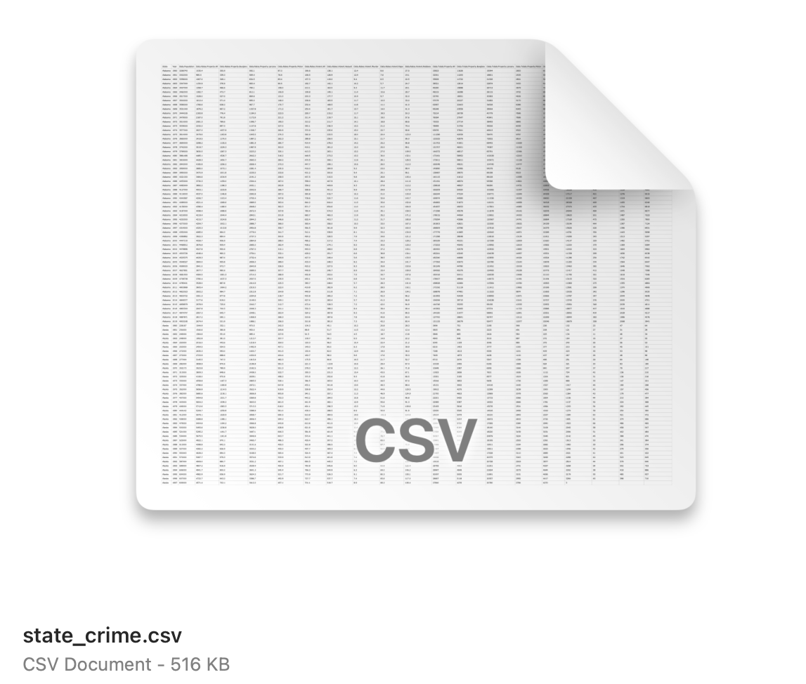
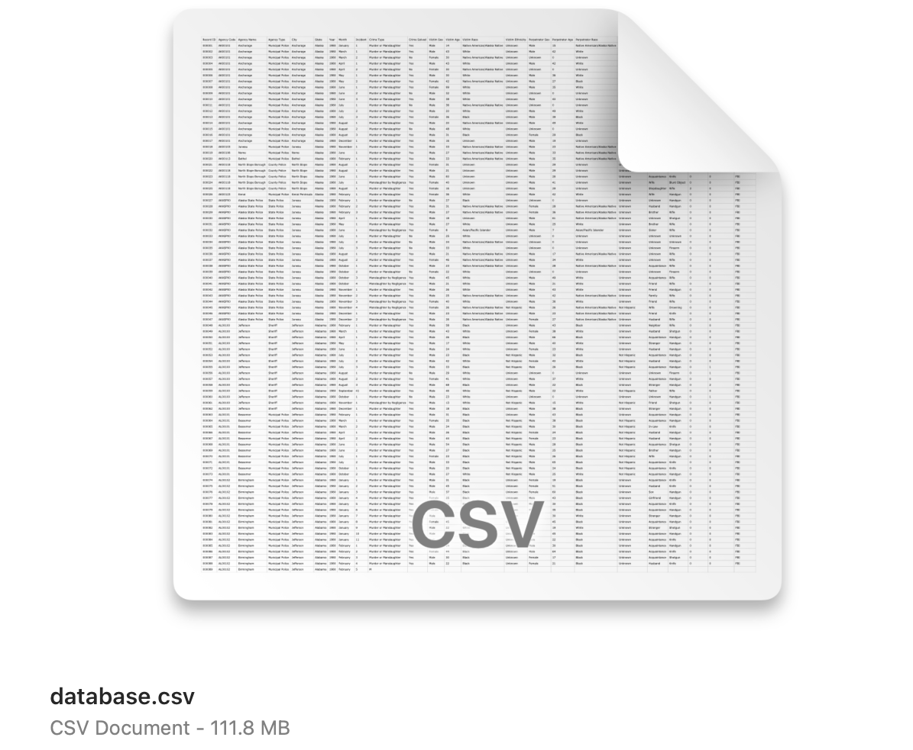
3. Data Storage:
The state_crime dataset that we saved in a .csv file had a size of 516 KB. (Source: Kaggle)
The database dataset that we saved in a .csv file had a size of 111.8 MB. (Source: Homicide Reports, 1980-2014 Kaggle)

Slide 9
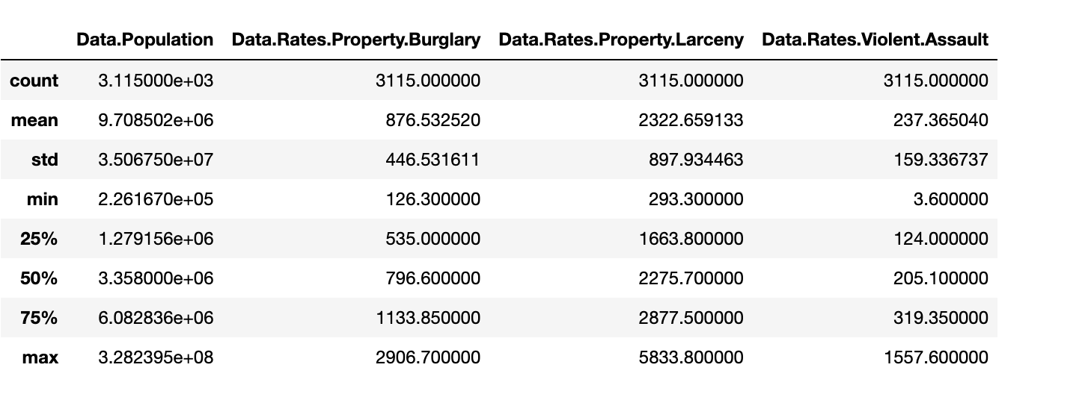
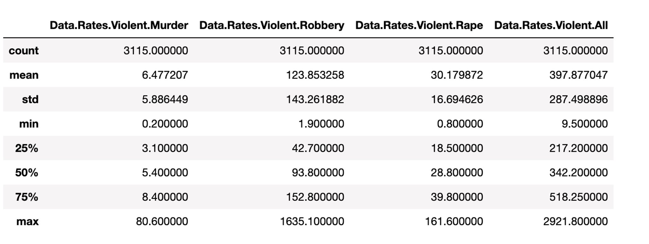
4. Statistical Description:
Here is the statistical summary of our dataset 'state_crime.csv'.

Slide 10
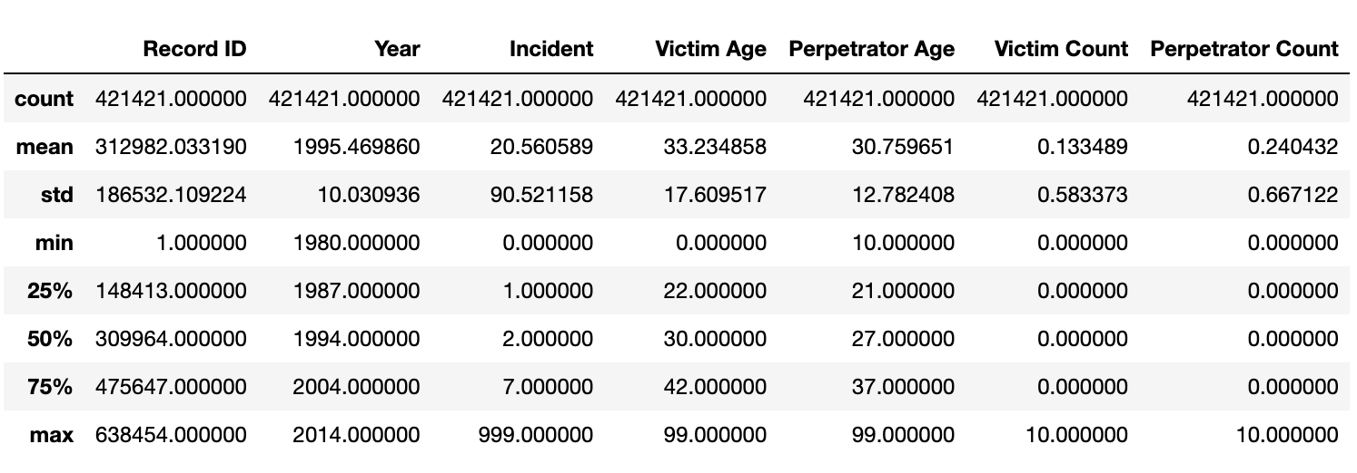
Here is the statistical summary of our dataset 'database.csv'.

Slide 11
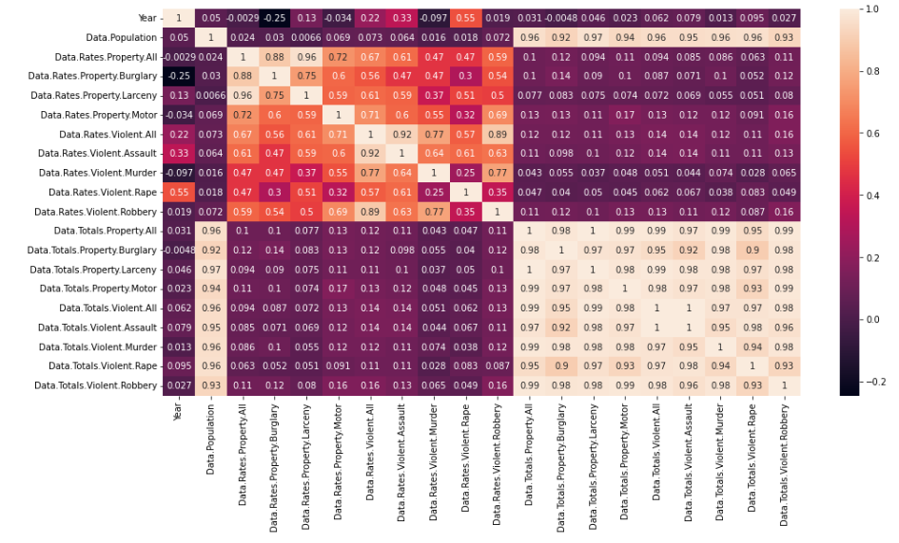
5. Variable Relationship:
This heatmap shows the correlation between the variables in our 'state_crime' dataset.

Slide 12
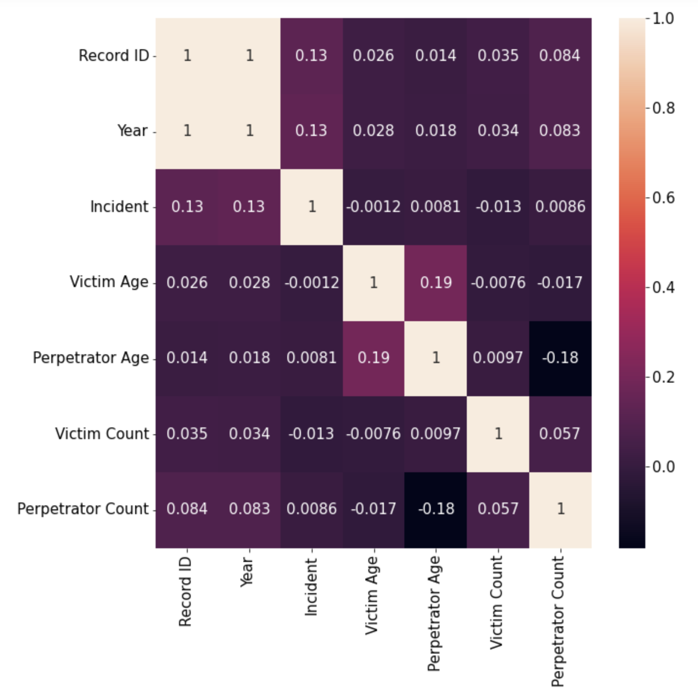
This heatmap shows the correlation between the variables in our 'database' dataset. There is no significant correlation

Slide 13
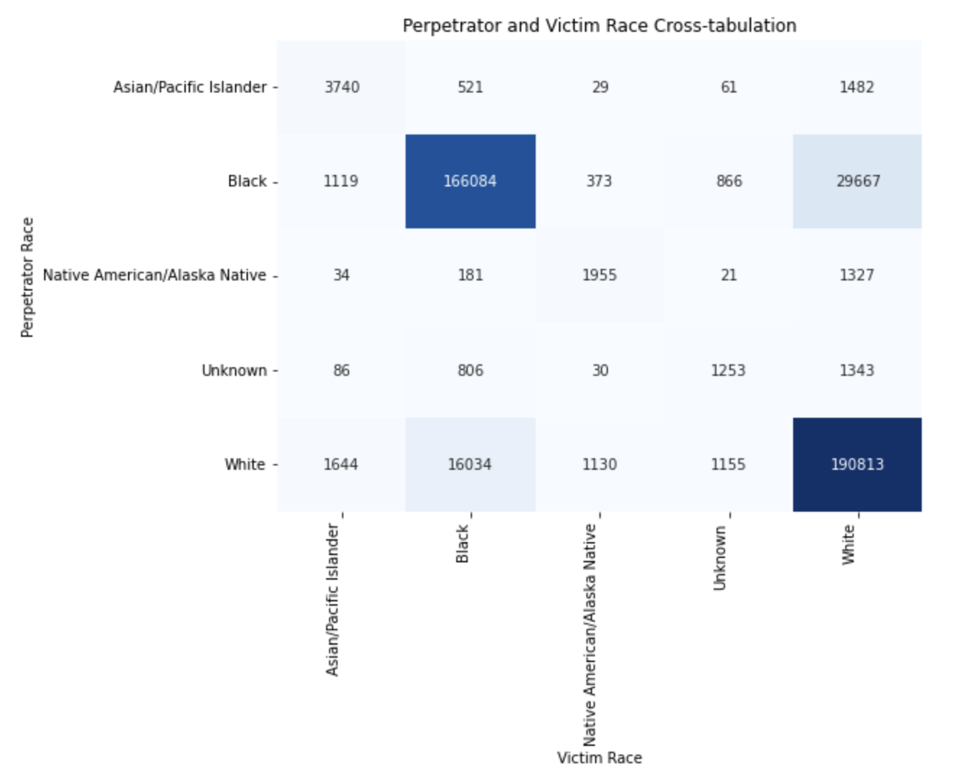
6. Plots:
This heatmap helps to show the relationship between perpetrator race and victim race in the given dataset, with darker shades indicating a higher frequency of incidents involving that particular race combination.

Slide 14
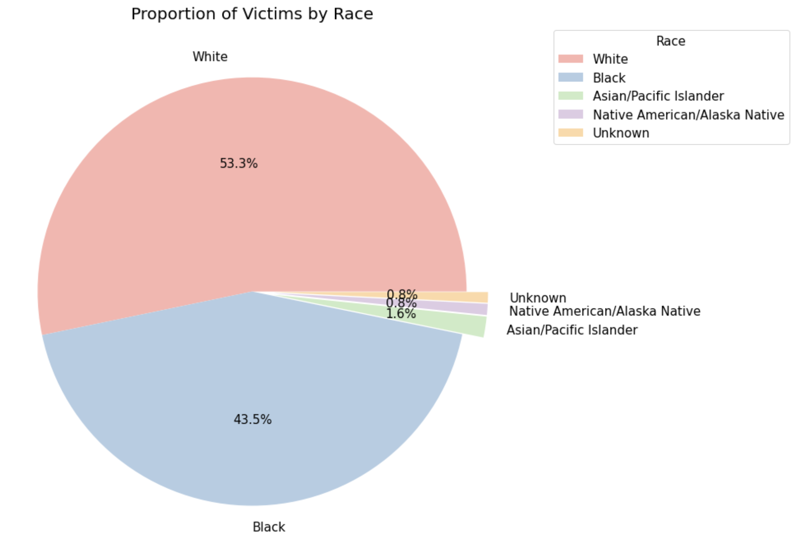
The pie chart include the racial breakdown of victims in the dataset, with White victims being the largest group, followed by Black victims. The chart also highlights the smaller percentage of victims from other racial groups.

Slide 15
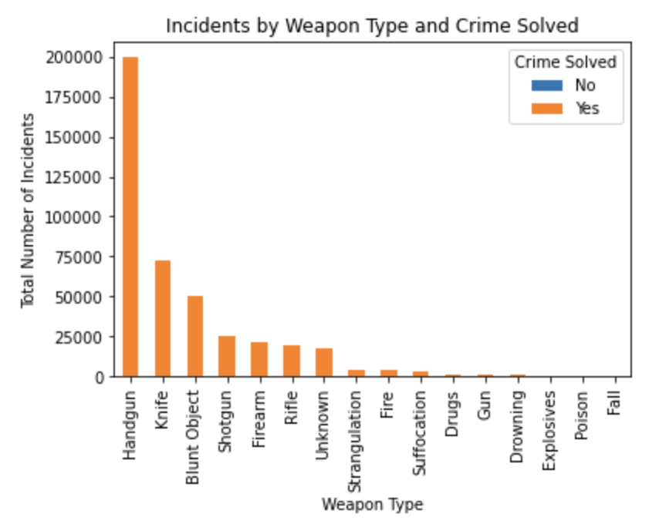
The stacked bar chart shows the number of incidents by weapon type and crime solved. The x-axis shows the different weapon types used in the incidents, and the y-axis shows the total number of incidents. The bars are stacked to show the breakdown of crime solved ('Yes' or 'No') for each weapon type.

Slide 16
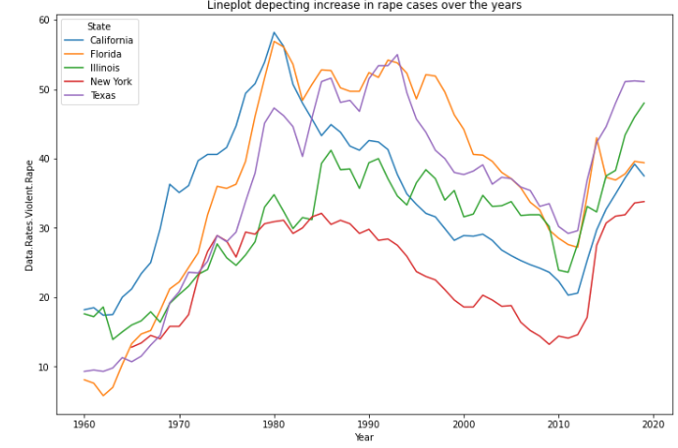
A Line Plot for Rape cases over the years define data as points or check marks above a number line, showing the frequency of each value. It is a basic type of chart common in many fields.

Slide 17
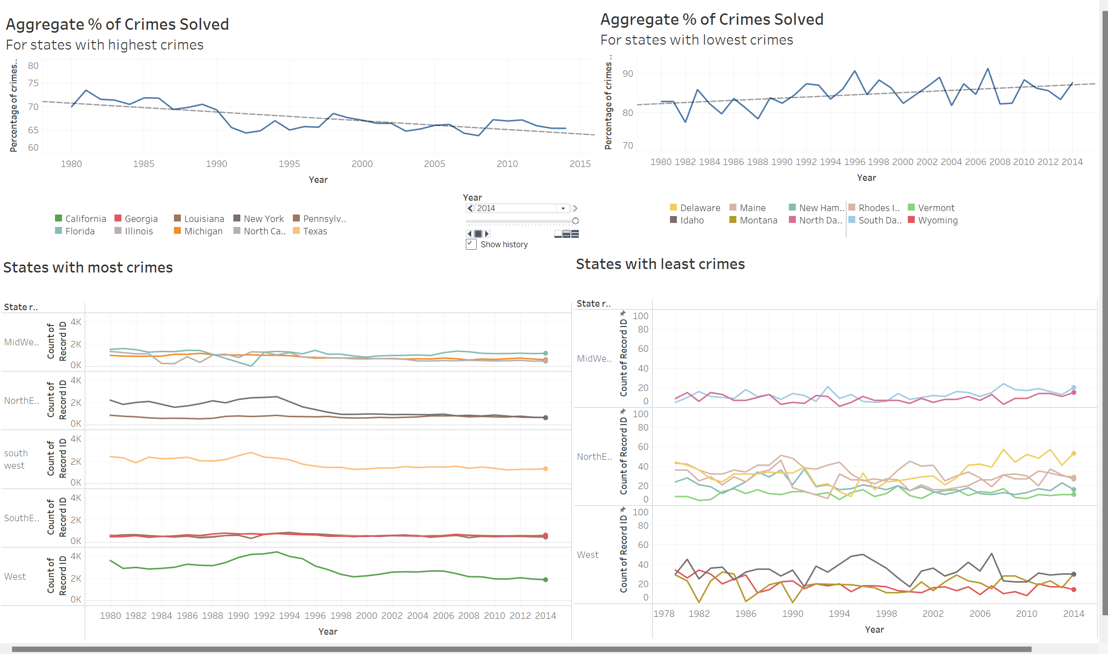
7. Interactive Visualizations:

Slide 18
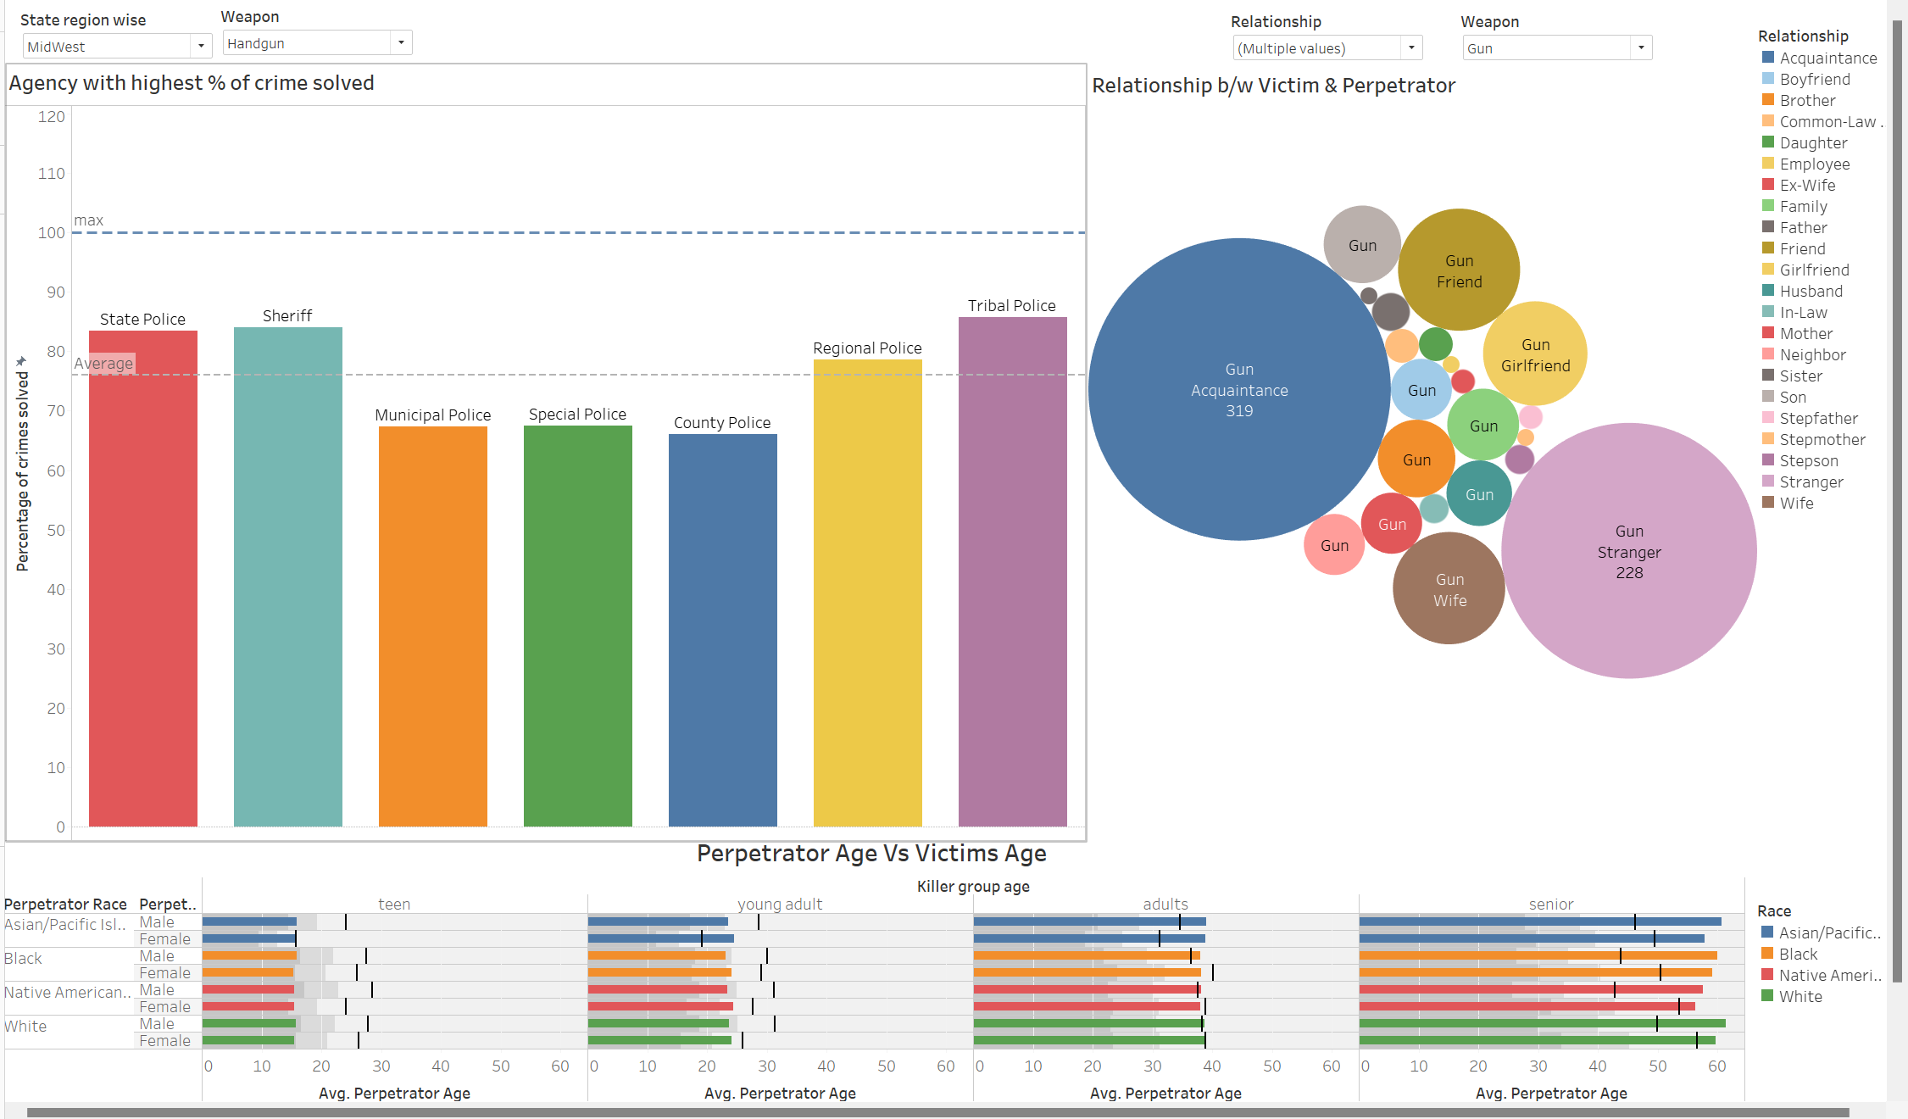

Slide 19
8. Key takeaways:
Trends of different crimes over the years were analysed
The race of victims who were most affected was determined
The relationship between the perpetrator and victim was explored
The number of crimes solved out of the total reports was analysed
The types of weapons used in crimes were identified
States with the highest and lowest number of reported crimes were identified

Slide 20
Questions?

